Slide 1

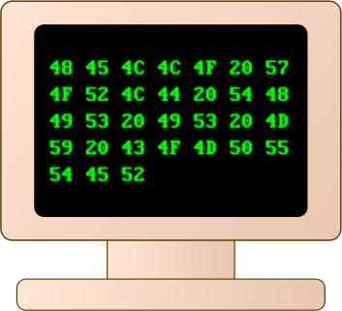

09 – A Micro Programmed Machine
COMP 256 – Dickinson College
Prof. Braught
Spring 2022
Images from: openclipart.org

Slide 2
Machine Abstractions
General purpose programmable computers can be understood at different levels of abstraction:
Physical Machine
Micro-Program Machine
Machine Language Machine
Assembly Language Machine
High-Level Language Machine
There are also several important architectural abstractions:
The Stored Program Architecture
The Instruction Cycle (Fetch/Decode/Execute)
Memory Hierarchy & Cache
Pipelining and Parallelism
Notes:
Don’t spend much time here.
For levels of abstraction…
- we have seen the physical machine
- from electrical voltages to 0-1, to transistors, go gates, to circuits, to programmable circuits.
In this unit we will look closely at
- Micro-program machine – programmable very directly with 0’s and 1’s
- Machine language machine – still 0’s and 1’s but a higher level of abstraction
We will also see some abstractions that underly how modern machines operate.
- Don’t go into them here…

Slide 3
Early Electronic Computers
Early electronic computers were not general purpose.
“Programming” required physical rewiring and setting knobs and switches to create a machine that performed the desired computational task.
Colossus – 1945
Tommy Flowers, Bletchley Park, UK
ENIAC – 1945
John Mauchly, J. Presper Eckert, Penn
Notes:
That physical rewiring…
- Like building a bunch of circuits like in the lab
- where each computes a particular set of functions
- then setting each to perform the appropriate operation
- and connecting the outputs of one to the next to compute a sequence of operations
- i.e. a program.
You’ll learn more about these machines and a few others in a video in the activities.

Slide 4
The Knob and Switch Computer
Data Path
Registers (R0-R3)
Busses (A, B, C)
Arithmetic and Logic Unit
ALU
Notes:
The Knob & Switch Computer is designed to
- build experience and intuition about how computers are organized and how they process information.
- It will help us understand how a computer can be programmed with 0’s and 1’s.
Makes it visual and allows us to interact with it.
Registers: Temporary storage for values used in the machine’s calculations
- more permanent storage later.
Busses: wires that connect the different components and allow the electrical signals to move between them.
ALU: Performs the actual computations

Slide 5
The Knob and Switch Computer Datapath
https://dickinson-comp256.github.io/Knob-And-Switch-Computer/datapath.html
DEMO!
Notes:
Type in some values
- use small positive and negative values
- checkable by hand
Click some knobs
Run R2 = R0 + R1
- Talk through the animation.
- Change the animation speed.
Change to Base 2 and check values.
- (+-10 uses Two’s complement representation)

Slide 6

Try It!
https://dickinson-comp256.github.io/Knob-And-Switch-Computer/datapath.html
Multiply the value of a register by 2 and place the value in another register.
Assuming all registers have a non-zero value, set one register’s value to 0.
Replace the value in a register with its complement (e.g. replace -235 with 235). Your solution should work regardless of what is in the other registers.
Multiply the value in a register by 7. Use as few steps as possible.
Work in pairs to use the settings in the Knob & Switch Datapath to perform these tasks.
Notes:
Work on these for a little while.
Have a report out on ideas and questions.
Leave enough time to cover the rest of the materials.

Slide 7
Knob and Switch Computer with Main Memory
Main Memory (RAM)
Memory Locations
16-bit values
32 locations
5-bit addresses
Unsigned binary
Switches
Notes:
In the homework you will work with two more versions of the K&S computer.
Each adds a little more complexity and a little more power.
The first is the K&S with Main Memory.
The 4 Storage locations provided by the registers are not much.
So we will a Main Memory to hold more data
- When you talk about the RAM in your computer this is what you are talking about.
- K&S’s Main Memory is really small (32 locations)
- compared to the 4, 8, 16 + GB that you have.
- A giga is about 1 billion so 4, 8 or 16 billion locations
- But the idea is exactly the same.
Every loocation in the K&S
- holds 16 bits.
- has an addrss so that we can refer to it.
- addresses are 5-bits long in unsigned binary
- Can also see in base 10.
Use the switches to change how data moves.
- move from registers to registers (as before)
- Move from memory to registers
- Move from registers to memory (thorugh the ALU)
Be careful not to connect two inputs to C-Bus at the same time.
- Data collision – bad news… corrupted results.

Slide 8
Programming the K&S?
How might we create a program for the K&S using only 1’s and 0’s?
Notes:
Do a little brainstorming.
No need to get it exactly right.
The details come out in the homework.

Slide 9
The Knob and Switch Computer (v3)
Microinstructions are an abstraction for the machine configuration.
0’s and 1’s encode knob and switch positions.
A micro-program is a sequence of micro-instructions.
Notes:
I can think about programming the machine using 1’s and 0’s instead of switches and knobs.
- we just need to agree on a way to encode
- the position of each knob
- the state of each switch
- the memory location to be used.
Once we agree on that, we can write down machine configurations as a series of 1’s and 0’s.
Write down a sequence of those configurations
Execute them one after the other and we have a program!
(Set one up in advance and run it just to see it go)

Slide 10

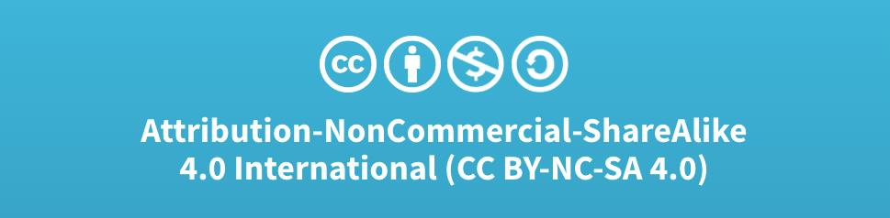
Acknowledgments
Slide Template From:
https://creativecommons.org/licenses/by/4.0/
Slide Content Licensed as:
Creative Commons Attribution-NonCommercial-ShareAlike 4.0 International License.

Slide 11
The Knob and Switch Computer (v1)
Data Path
Registers (R0-R3)
Busses (A, B, C)
Arithmetic and Logic Unit
ALU
Number Base
Notes:
Can display the contents of the machine in a variety of different representations.

Slide 12
The Knob and Switch Computer (v1)
Data Path
Registers (R0-R3)
16 bit values (word size)
Busses (A, B, C)
Arithmetic and Logic Unit
ALU
Number Base
+- 10 (Two’s Complement)
10 (Unsigned Binary)
2 (Show the bits)
Notes:
See that Registers hold 16 bits:
- 16 bits vs 64 bit machine
The

